Slide 1
Stats 240 Final Presentation
Group 6: Andrew, Ami, Indu

Slide 2
Introduction
We were interested in how much is being done to combat the growing housing shortage especially for low income families.
We set out to find data that compared the number of low income households to the number of middle income households that are being produced in a refined area.
We found our data set on NYC Open Data which allowed us to test our hypothesis on New York City.
The dataset included all the housing projects that were produced in New York City since 2014 and were classified by income class.

Slide 3
Statistical Testing
In order to answer the question is anything being done to combat the housing shortage especially for low income families we used the data to compare the number of low income households to the number of middle income households that were produced since 2014.
We set our null hypothesis as there is no difference between the number of low income households and the number of middle income households that have been produced since 2014.
After conducting a 2 sided Z-Test and found a p-value of essentially 0 meaning that there was a significant difference between the number of low income households and middle income households that were produced since 2014.

Slide 4
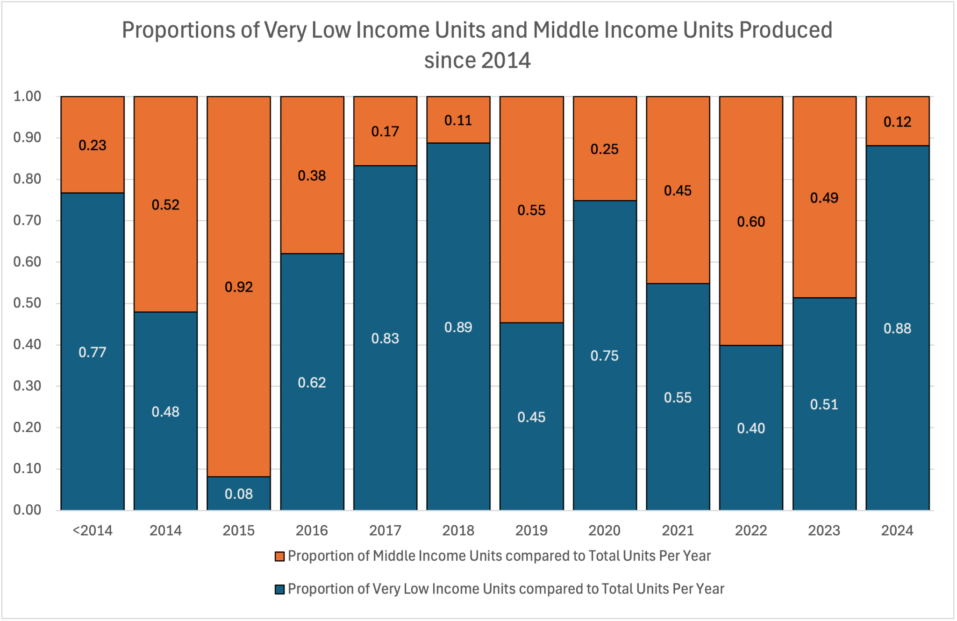
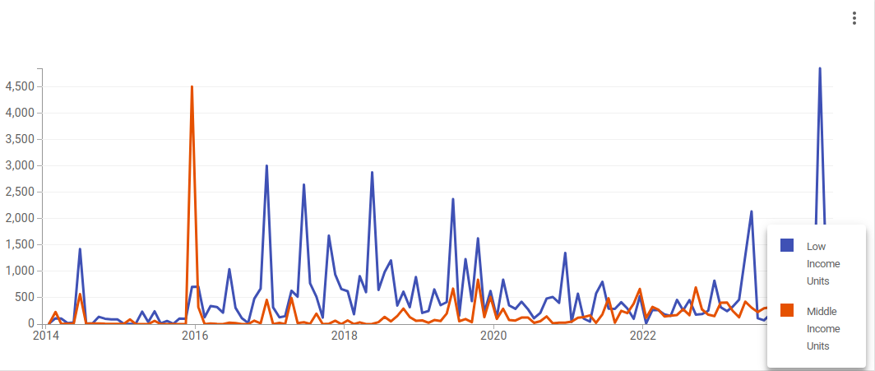
Statistical Analysis
After finding a p-value of nearly 0 we made visualizations to show that in the majority of years there is a greater amount of low-income housing that is produced compared to that of middle income housing,
Answering our question that from the data it seems like there is something being done to help low-income families when it comes to housing.

Slide 5
Questions?

